Slide 1
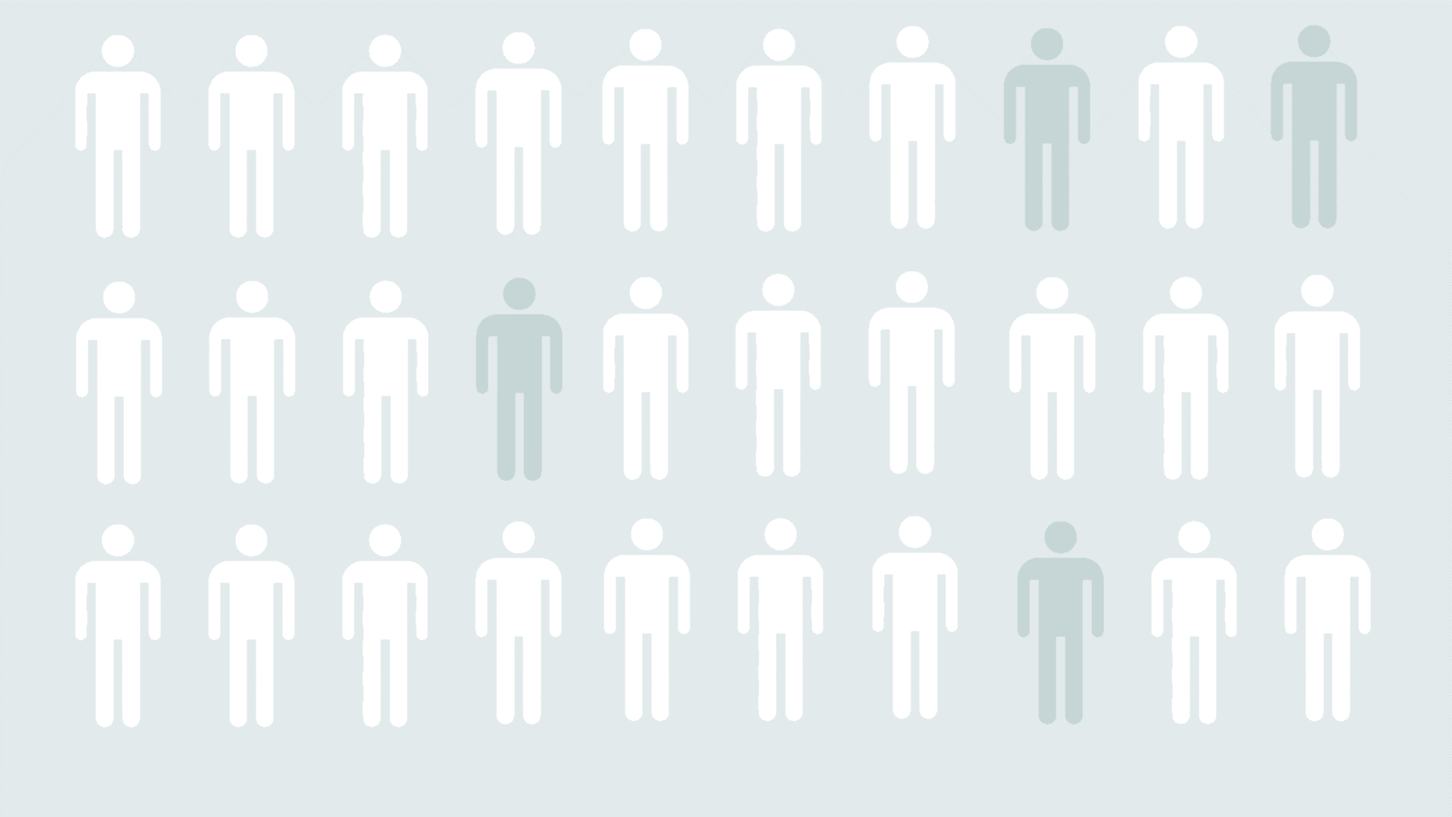

What Factors are correlated with Unemployment and can they be used to address the issue
Kyoungho Kim
Jordan Gates
Joomart Achekeev
* the logo is used for entertainment reasons only and does not belong to any members of the group

Slide 2
contents
Introduction
Data
Code flow
Insights
Models
Conclusion
Recommendations

Slide 3
Introduction
Unemployment – one of the indexes that depicts the overall health of the economy of a country.
The ‘normal’ is considered to be under 5% of the total population
Unemployment rate at the moment is 4.2% according to the department of labor statistics
Unemployment rate in 2010 was 9.6 %

Slide 4
Problem statement
What factors correlate with the unemployment and can they be used to predict the unemployment rate in a random US county?

Slide 5
Data
The final dataset used for the project was based on information collected from numerous resources such as US Census, FBI, MIT, Department of Labor Statistics and others.
Data was collected in regards to the counties of the US.
2010 was the year that most of the collected information had data on.

Slide 6
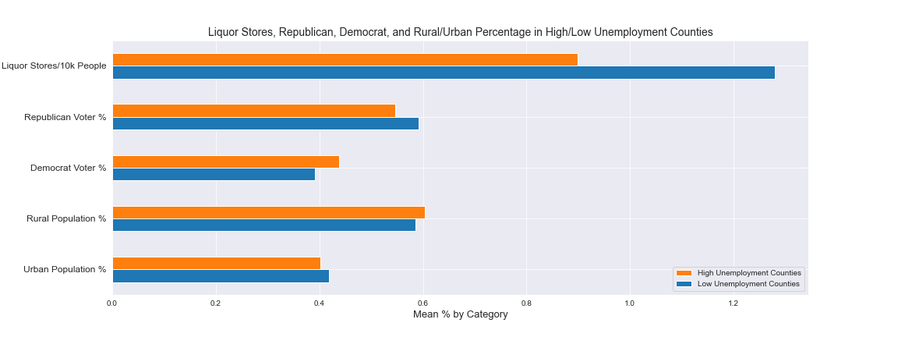
Insights
On average, there were significantly more liquor stores per 10k people in counties with lower than average unemployment
Counties with a higher than average unemployment rate tended to have more people who voted Democrat than Republican
Higher unemployment counties had a slightly higher rural population on average

Slide 7
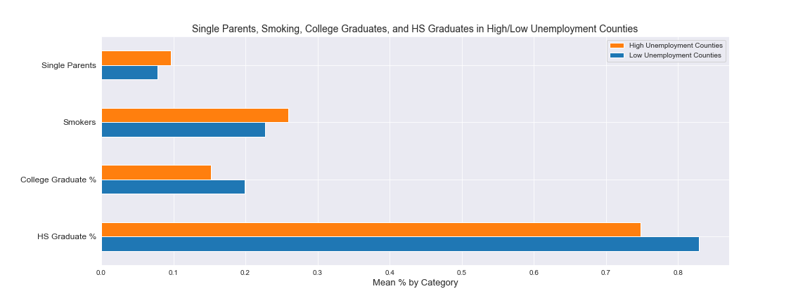
Insights
Counties with a higher than average unemployment rate also displayed higher numbers of single parents and smokers
Counties with a lower than average unemployment rate tended to have a slightly higher percentage of high school and college graduates

Slide 8
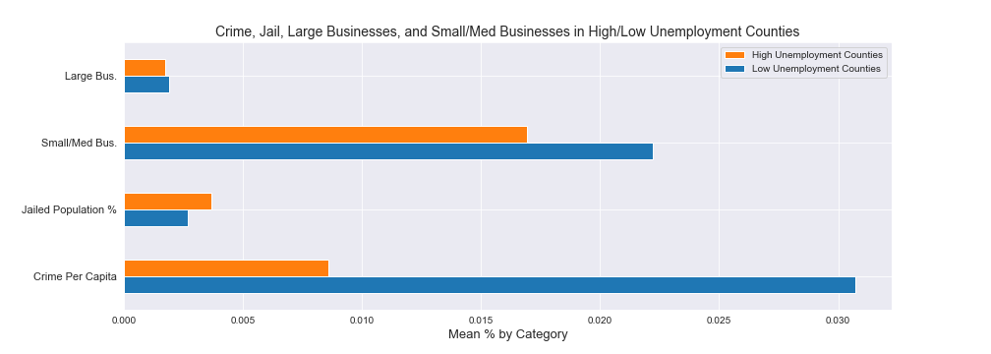
Insights
Counties with lower than average unemployment rates tended to have significantly more small to medium size businesses than higher than average unemployment counties
Lower than average unemployment counties tended to have a lower amount of their population in jail, but a noticeably higher amount of crime per capita

Slide 9
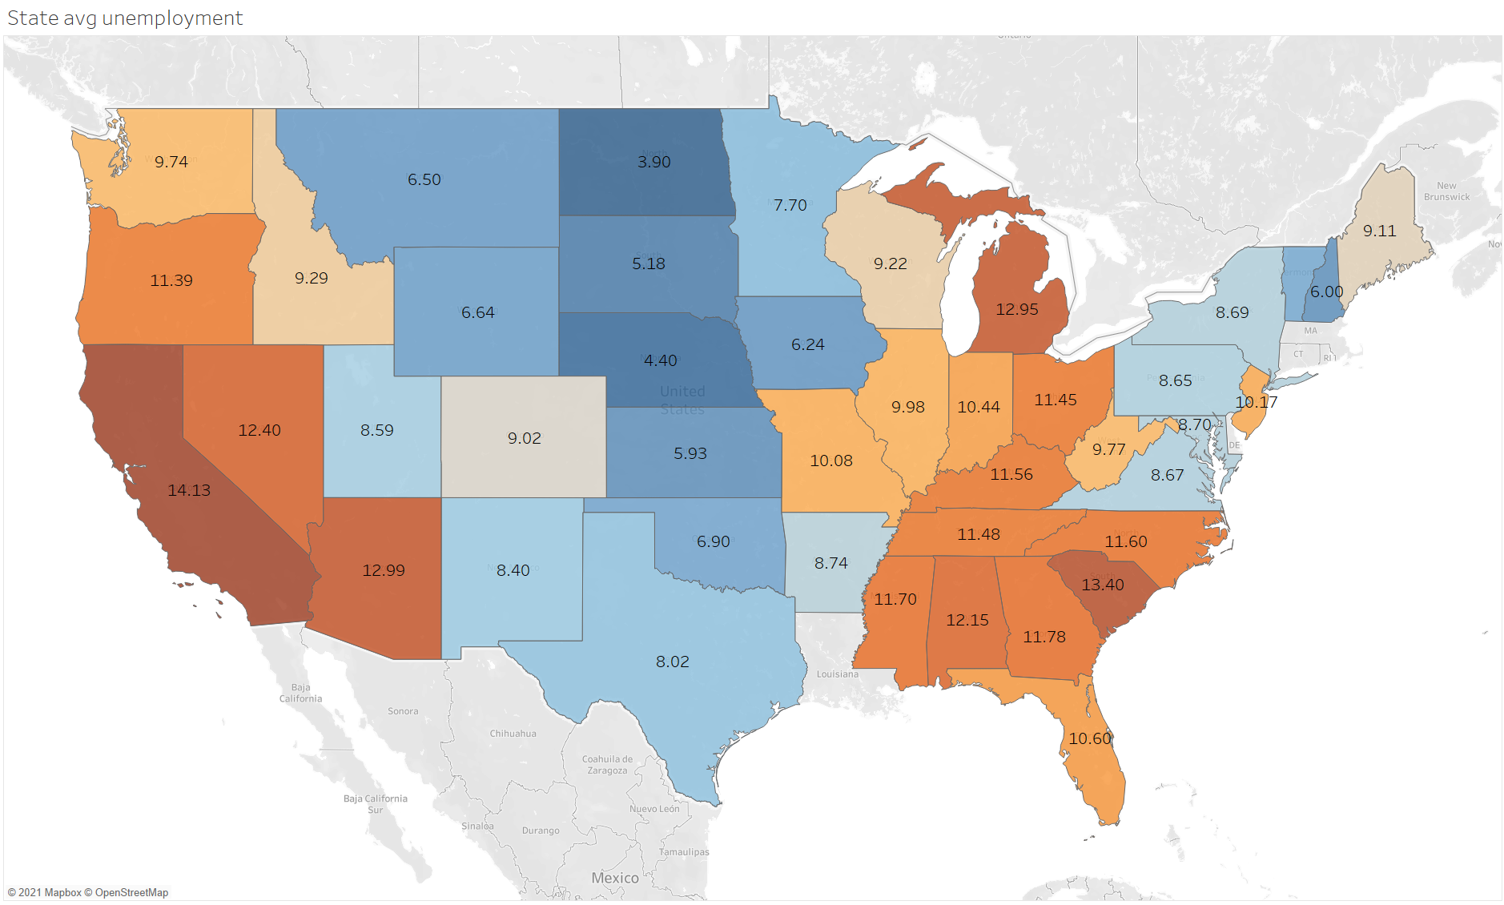
Insights

Slide 10
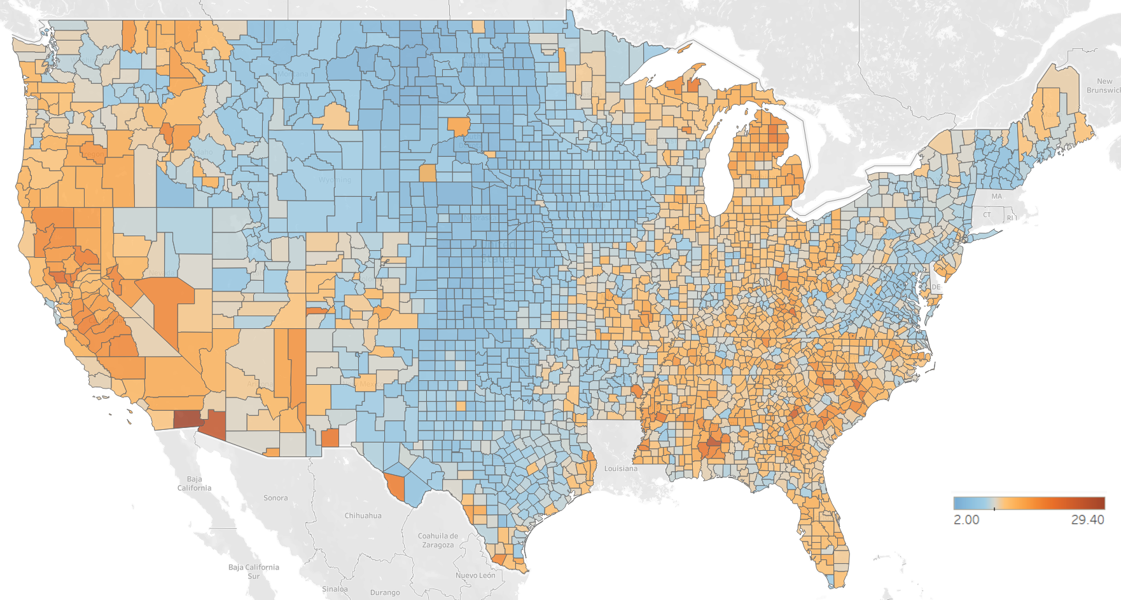
Insights

Slide 11
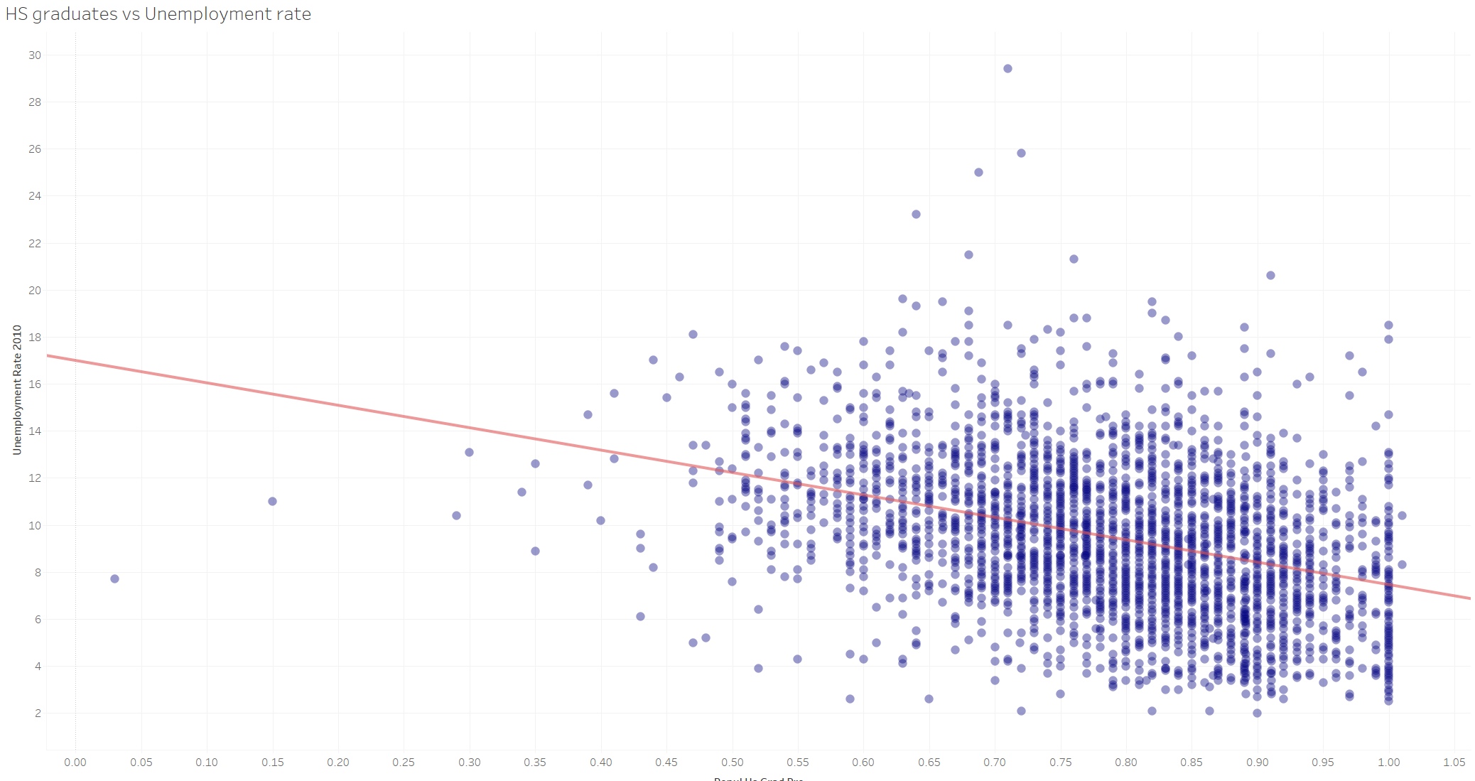
Insights

Slide 12
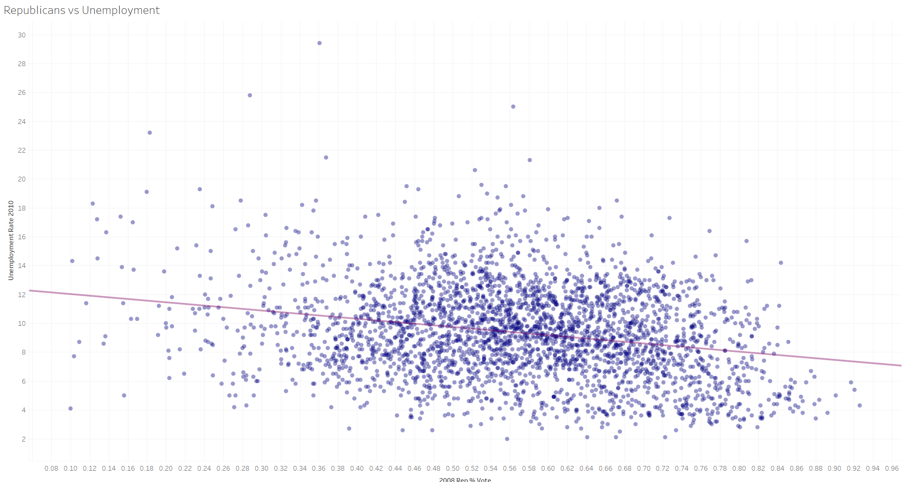
Insights

Slide 13
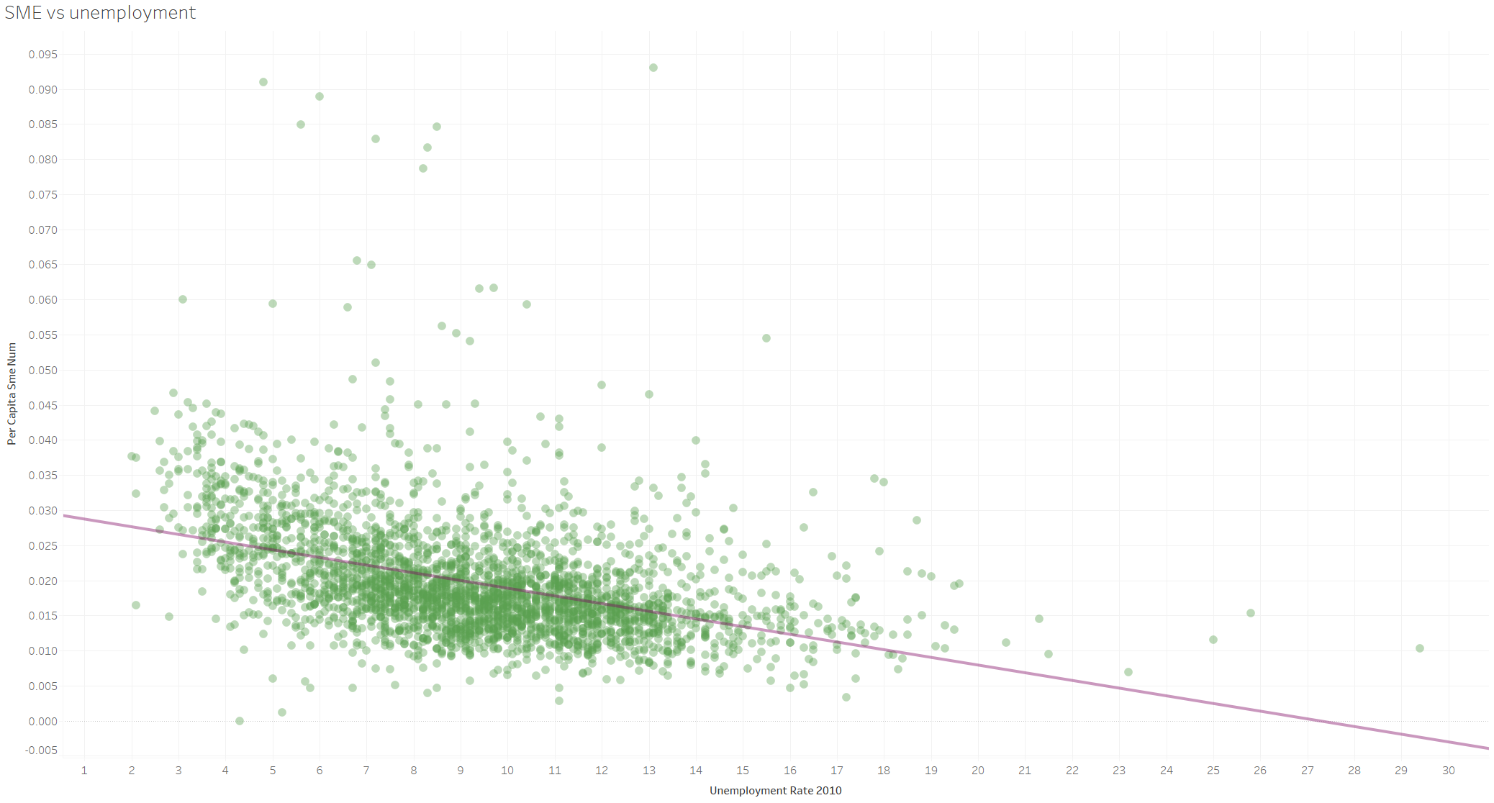
Insights

Slide 14
CODE
The main code work was done on the data cleaning, and defining the interaction columns to include into the dataset that would be used for modelling.
Code for defining the interaction columns was based on identification of the best correlation cutoff percentages for the data and happened to be -.25 and .75

Slide 15
Models
Linear regression on the original data
Linear regression on the engineered data
Linear regression on PCA
Neural network on the engineered data
Second level data hand fed predictions from LR and NN

Slide 16
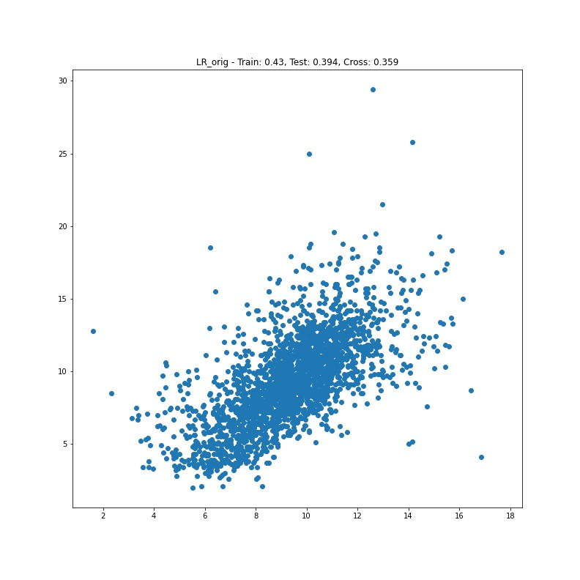
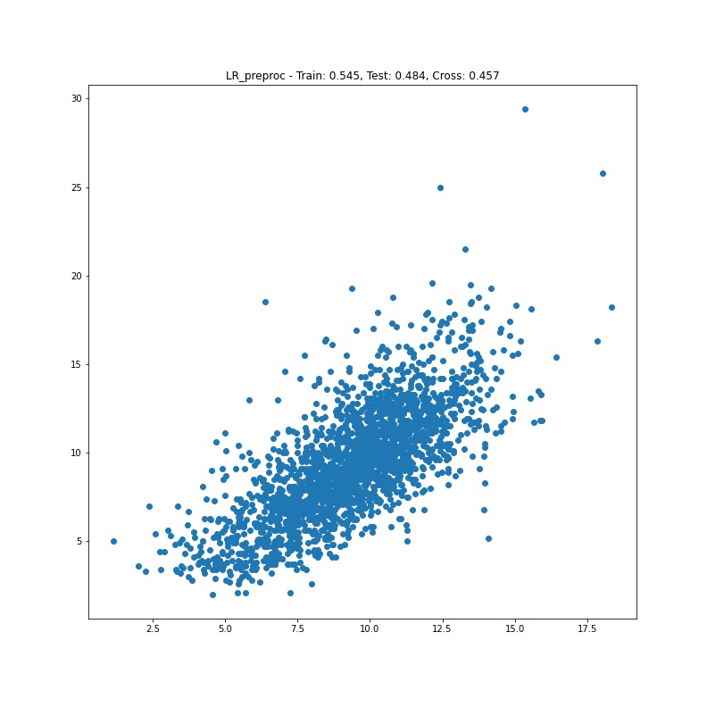
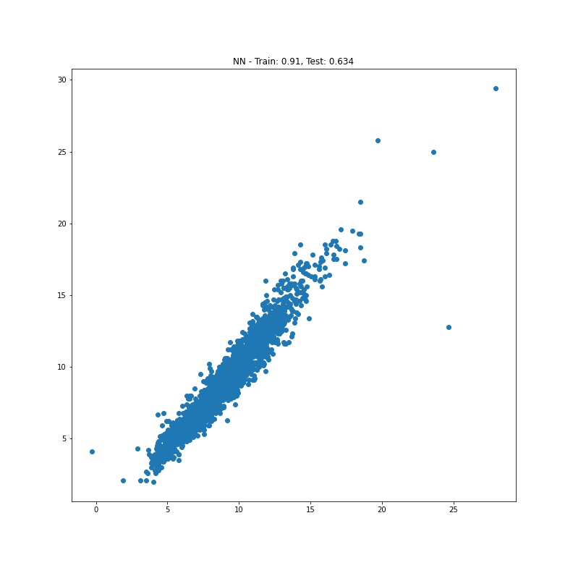

Models progress

Slide 17
Conclusion
This was a vital experience of close to real life project implementation
We’ve learned many things and repeated even more
Teams are much better when having limited time since each person is stronger then others in one thing and team members complement each other’s skills
The clear goal in the beginning is half of the job done
Data, data, data – how to get it and not violate laws, regulations, ethics, other people’s private space.
We as Data Scientist are hungry for data, but each data point is someone else’s life. Sometimes people working with data need to take a step back and understand that there are people behind those numbers.

Slide 18
Sources
https://www.ers.usda.gov/data-products/county-level-data-sets/download-data/
https://www.epi.org/data/
https://www.census.gov/data/tables/2010/econ/susb/2010-susb-annual.html
https://taxfoundation.org/
https://www.irs.gov/statistics/soi-tax-stats-county-data-2018
https://www.census.gov/programs-surveys/geography/guidance/geo-areas/urban-rural/2010-urban-rural.html
https://www.nass.usda.gov/Publications/AgCensus/2017/Full_Report/Volume_1,_Chapter_2_County_Level/
https://dataverse.harvard.edu/dataset.xhtml?persistentId=doi:10.7910/DVN/VOQCHQ
https://www.ers.usda.gov/data-products/county-level-data-sets/download-data/
https://data.census.gov/cedsci/table?q=United%20States&g=0USfalse_0100000US%240500000&tid=ACSDP1Y2017.DP05&hidePreview=true
https://www.census.gov/data/datasets/time-series/demo/popest/intercensal-2000-2010-counties.html
https://www.census.gov/data/datasets/time-series/demo/popest/2010s-counties-detail.html
https://worldpopulationreview.com/us-counties
https://www.icpsr.umich.edu/web/NACJD/studies/36399/datadocumentation
https://www.icpsr.umich.edu/web/NACJD/search/studies?q=&SERIESFULL_FACET_Q=57%7CUniform%20Crime%20Reporting%20Program%20Data%20Series
https://ucr.fbi.gov/crime-in-the-u.s/2010/crime-in-the-u.s.-2010/tables/10tbl80.xls/view
https://www.bea.gov/data/income-saving/personal-income-county-metro-and-other-areas
https://www.dol.gov/general/topic/statistics/wagesearnings
https://advisorsmith.com/data/coli/

Slide 19
Thank you for your time
Questions?

